Slide 1
PERSPECTIVES ON CHARITIES LAW, ACCOUNTING AND REGULATION IN NEW ZEALAND CONFERENCE
CLAANZ
26 and 27 April 2018

Slide 2
Session 7: Tax Issues
“As counsel for the Attorney-General remarked in the course of the argument the law of charity is bedevilled by the fact that charitable trusts enjoy two quite different sorts of privilege. On the one hand, they enjoy immunity from the rules against perpetuity and uncertainty and though individual potential beneficiaries cannot sue to enforce them the public interest arising under them is protected by the Attorney-General. If this was all there would be no reason for the courts not to look favourably on the claim of any purpose trust to be considered as a charity if it seemed calculated to confer some real benefit on those intended to benefit by it whoever they might be and if it would fail if not held to be a charity. But that is not all. Charities automatically enjoy fiscal privileges which with the increased burden of taxation have become more and more important and in deciding that such and such a trust is a charitable trust the court is endowing it with a substantial annual subsidy at the expense of the taxpayer. Indeed, claims of trusts to rank as charities are just as often challenged by the revenue as by those who would take the fund if the trust was invalid” (Lord Cross, Dingle v Turner [1972] AC 601)
Charities unique legal and social organisation:
Established for “the public benefit” and protected by Crown
Subject to important legal immunities and concessions (particularly tax concessions)
Tensions and links between charity and tax policy settings still “bedevil” charity practice and these two imperatives still walk “arm in arm” (Dingle) (concept tax charity illustrates this as does link tax ruling and registration requirements)

Slide 3
Session 7: Tax Issues
At a macro level, any serious discussion about taxation’s influence on charity law and practice needs to recognise that:
Tax concessions central to many charity’s existence
Key legal/tax concepts underpin all relevant legislative frameworks (“private pecuniary profit”, “established and maintained exclusively for charitable purposes”, “gift”, “charitable purposes not limited to New Zealand, etc.”)
Handful of taxation rules regulate tax concessions, some of rules old and uncertain in application, little guiding legal authority
Helpful practical guidelines and information published by Inland Revenue and Charities Services
2 major regulators involved (Charities Services and Inland Revenue) often unclear who doing what, extent of co-operation, secrecy protocols, etc.
Whole area needs more unified approach and some rules need reform

Slide 4
Session 7: Tax Issues
At a micro level, three specific charity/tax areas are now discussed in more detail to illustrate these themes
Entering and exiting the registered charitable sector
Cross-border challenges involving offshore charitable purposes/activities
Donation tax concessions
Internationally these areas generate important tax/charity qualification and boundary issues requiring specific and clear legislative responses and charities do not have surplus money to spend on tax problems in this context

Slide 5
TAX ISSUES AND CHARITIES Entering and exiting the registered charitable sector Cross border challenges Donation tax concessions
26 April 2018
Presenters: Andrew Babbage, Stewart Donaldson, Denham Martin

Slide 6
ENTERING THE SECTOR
Registration with DIA Charities results in automatic income tax exemption and approved donee status in most cases
Expect to contact Inland Revenue when you:
Apply for an IRD number,
Want to obtain donee status and you apply a high proportion of funds to charitable purposes outside NZ,
Have business income and carry out any charitable purposes overseas,
Wish to obtain a resident withholding tax certificate of exemption,
Register for GST, PAYE or other tax types
Statistics Snapshot
13,600 registered charities are also GST registered (about 50%)
20,000 registered charities have a certificate of exemption for resident withholding taxes (about 70%)
About 3,000-4,000 volunteers receive honoraria payments which have tax deducted at source

Slide 7
EXITING THE SECTOR
From 2014 new rules apply to deregistered charities
The rules ensure that if an entity has claimed income tax exemptions as a charity and has accumulated assets, these assets should always be destined for a charitable purpose, even if the entity is deregistered
To the extent net assets are not disposed of or transferred for charitable purposes within 1 year of deregistration, the deregistered charity will be subject to income tax on the value of those net assets
Statistics Snapshot
1,146 charities deregistered in the year ended 30 June 2017*
520 (45%) deregistrations were voluntary and 625 (55%) were due to failure to file returns
About 240 of the voluntarily deregistered charities told DIA they had net assets of $42m at the time of deregistration
*Source: “Our year in numbers” DIA Charities Services, 02/11/2017

Slide 8
CROSS BORDER CHALLENGES
Since 1940 charities have had to distinguish business income from non-business income (ss.CW 41/42). Business income is taxable to the extent the charity has purposes outside NZ
Donee organisations must apply their funds wholly or mainly to charitable, benevolent, philanthropic or cultural purposes within New Zealand, or be listed on Schedule 32
Statistics Snapshot
3,764 charities reported having overseas activities to DIA (about 14%)*
There are currently 138 ‘overseas donee organisations’ approved under schedule 32 of the Income Tax Act
*Source: “Our year in numbers” DIA Charities Services, 02/11/2017
xxx

Slide 9
DONATION TAX CONCESSIONS
Donation concessions were introduced in 1962. The concessions apply to monetary gifts of $5 or more made to donee organisations. From the 2008/2009 year the maximum claim for donors increased from $630 to 1/3rd of their taxable income (which, in some cases, is above $1 million)
Donee organisations must apply funds for charitable, benevolent, philanthropic or cultural purposes; the funds must be applied wholly or mainly to these purposes within New Zealand (or the organisation must be on Schedule 32)
Most charities receive donee status automatically when they register with DIA; state schools and education institutions also receive donee status automatically
Statistics Snapshot
22,500 registered charities have donee status (about 80%)

Slide 10
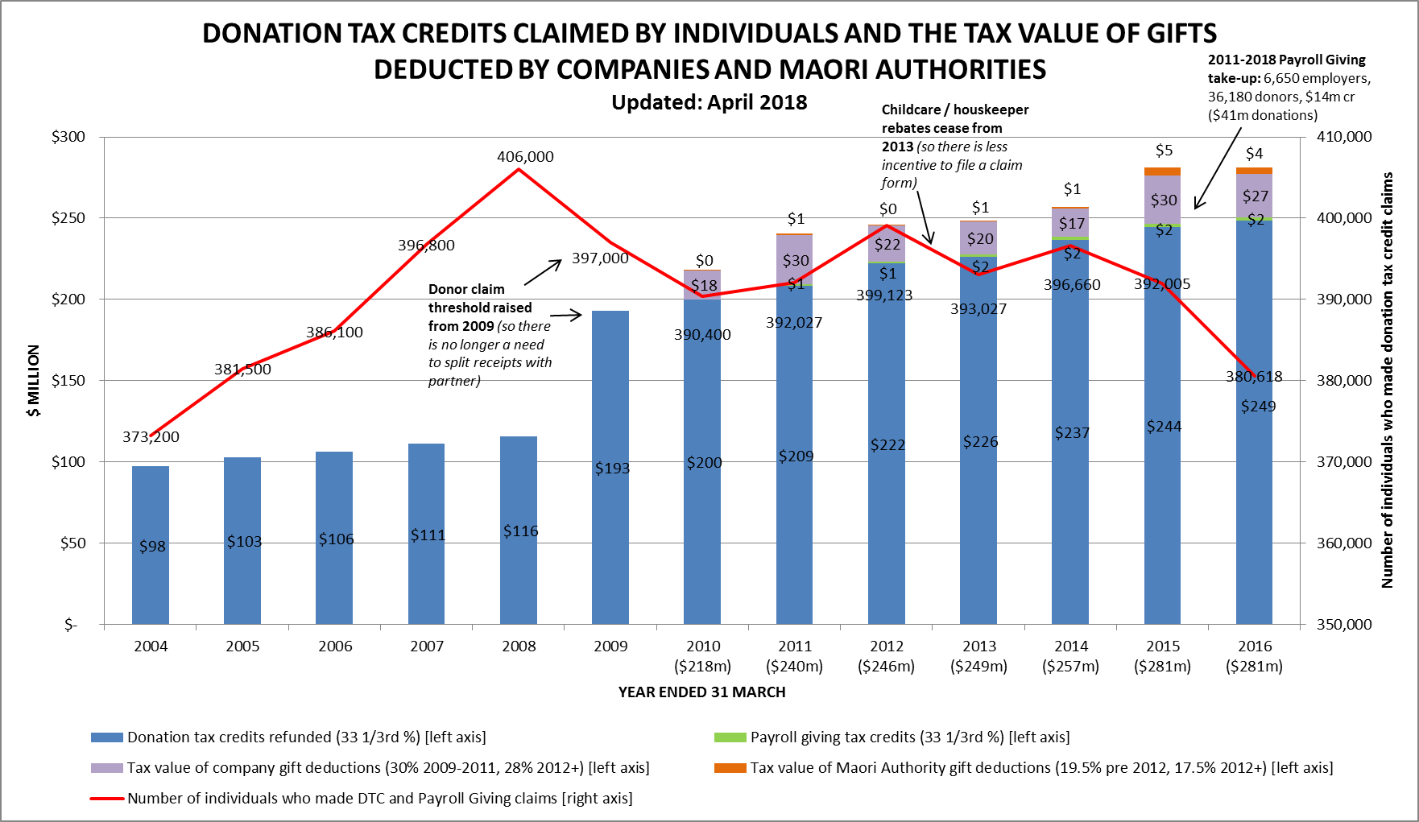
DONEE STATUS
5

Slide 11
Charities and Tax – some thorny issues
Andrew Babbage
April 2018

Slide 12
Charities and Tax
De-registration tax
Existing tax rules designed for ‘vanilla’ scenario where entity becomes a registered charity from creation
No specific tax rules for existing businesses entering the charitable sector – general principles / tax practice applies
Tax rules do not cater for existing businesses exiting the charitable sector
e.g. Maori organisations or large charities acquiring significant commercial enterprises/ asset-owning companies etc that may be sold in the future
Is this the new “Hotel California”?
Punitive rules on exit – no clear underlying policy
Asset value generated while entity was a taxpayer is potentially taxed again on exit – double taxation will arise
Tax should only be imposed on asset accumulations during the period the entity was a charity, i.e. claw back / capture tax on assets that were accumulated during the period it enjoyed charitable status
Instead, the rules tax the entire net assets on exit, irrespective of whether there was any accumulation of assets during period the entity was a registered charity
Greater discretion, flexibility needed

Slide 13
Tax Concessions for Donations
Current tax concessions for charitable donations consist of -
A tax deduction for companies
A tax credit for individuals
In either case, the qualifying donation is limited to the amount of the donor’s current year income
These tax concessions only apply to monetary gifts
No tax concessions available for cultural philanthropy – e.g. for gifting of artistic works, manuscripts, scientific collections, social history collections, taonga
New Zealand is an outlier compared to many other countries that have cultural gifting programmes – e.g. Australia, Canada, Ireland, USA
Recommendation from 2010 Taskforce – rejected by Treasury, IRD, MC&H. Issues about what items should qualify, valuation, basis for spreading the resulting tax benefit
Without support from officials, any change is unlikely
Bold vision lacking

Slide 14
Charities and Tax
Cross border challenges
General rule – passive income is able to be applied to charitable purposes outside New Zealand but business income is only exempt where the charity carries out its charitable purposes in New Zealand
Focus is on where the income is applied rather than where it has been earned
Apportionment possible where you have systems to track income sources and where they are applied
Can you stream business income to NZ projects?
Care is also needed if charity wishes to provide benefits offshore that this is consistent with trust deed

